Slide 1
PYTHON MINI PROJECT PATIENT MANAGEMENT SYSTEM
GUIDED BY :
PROF. PRASHANT SAWANT
MEMBERS :
HARSHIT SONAWALA (64)
MEET CHUDASAMA (70)

Slide 2
Table of Contents
INTRODUCTION
SCOPE
SOFTWARE USED
01
02
03
04
05
OBJECTIVE
IMPLEMENTATION

Slide 3
INTRODUCTION
Hospitals are an essential part of our lives. It is necessary for the hospital to keep track of all activities and records of its patient, doctors, nurses and other staff that keeps the hospital in its operation.
Keeping track of patient reports on paper is very inefficient and time consuming and also error prone. Thus to overcome this, we have developed a system called “Patient Management System”.
Patient Management System is designed specially to manage the records of patients quickly and in a systematic manner.
It can be especially helpful for smaller scale dispensaries and medical establishments.

Slide 4
OBJECTIVE
To computerize all details regarding the patients
Act as a effective solution for quickly querying the patient information
Provide a user friendly interface for managing the patient records
To provide accurate analytics based on the patient records at a glance.

Slide 5
SCOPE
This system can be used in any hospital, clinics, dispensary, to get information from the patients and store the data for future usage.
The intention of this system is to reduce management effort of the doctors and increase the number of patients that can be treated accurately.
We can enhance this system by including more facilities like pharmacy system for the stock details of medicine in the pharmacy.

Slide 6
IMPLEMENTATION
PyQt5 module is used to design and create the GUI of the application
On the click of the button, the data is read from the excel file using pandas module, stored in the SQLite3 database, and then the table is generated based on the data
It also allows for editing, inserting, deleting and clearing all the records
Finally the data can be saved back as an excel file

Slide 7





SOFTWARE USED
Python
PyQt5
SQLite3
pandas
Microsoft Excel
Matplotlib
Numpy

Slide 8
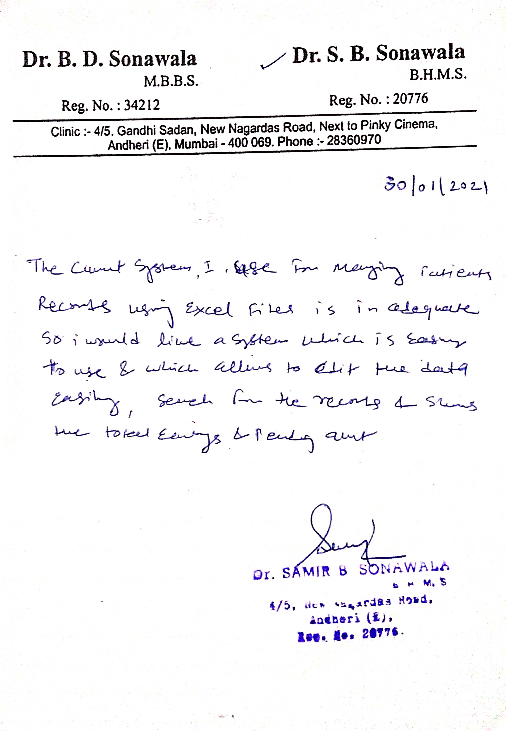
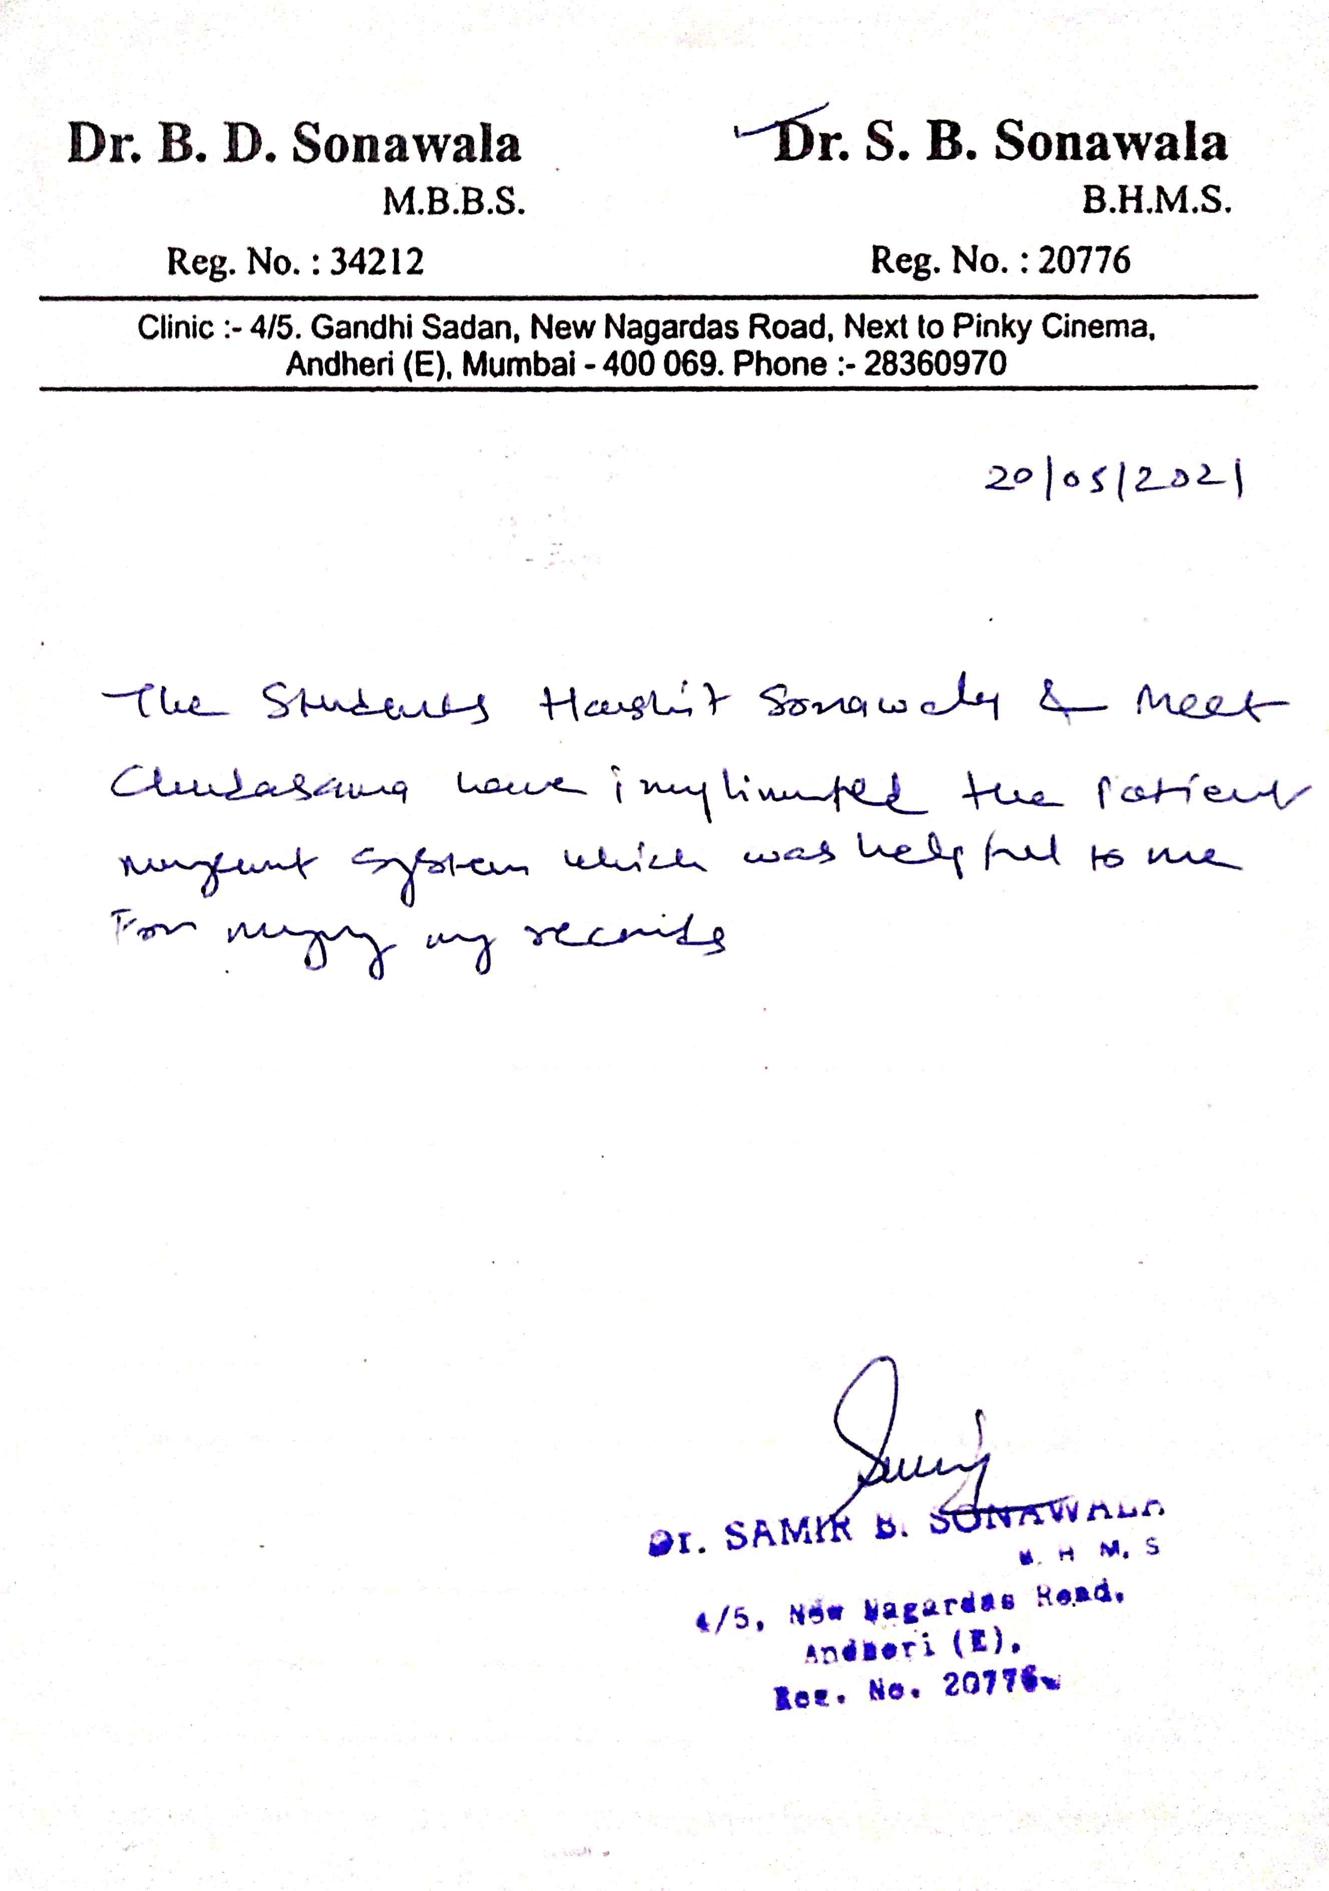
ACKNOWLEGDEMENT LETTER

Slide 9
Thanks!

